Slide 1
UNIX-BASED System Monitoring Report
By : B SAMVAV

Slide 2
Introduction
Monitoring a system is vital for maintaining reliable, available, and secure services. This guide highlights key metrics to track on a Unix-based system, along with sample commands to capture each metric. Command outputs are demonstrated with screenshots, making this report a practical resource for overseeing any Unix-based system.

Slide 3
CPU USAGE
Overview: Tracking CPU usage is essential for identifying processes that might be placing excessive demands on the system.
Commands:
top - Displays real-time information on active processes and CPU consumption.
htop - An interactive and visual variant of top.
iostat - Provides detailed statistics on CPU utilization.

Slide 4
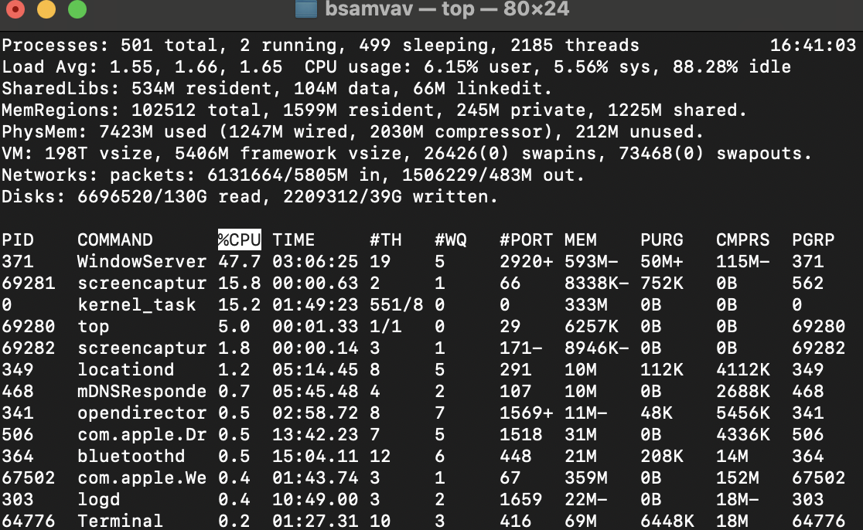
Sample Command and Output: top

Slide 5
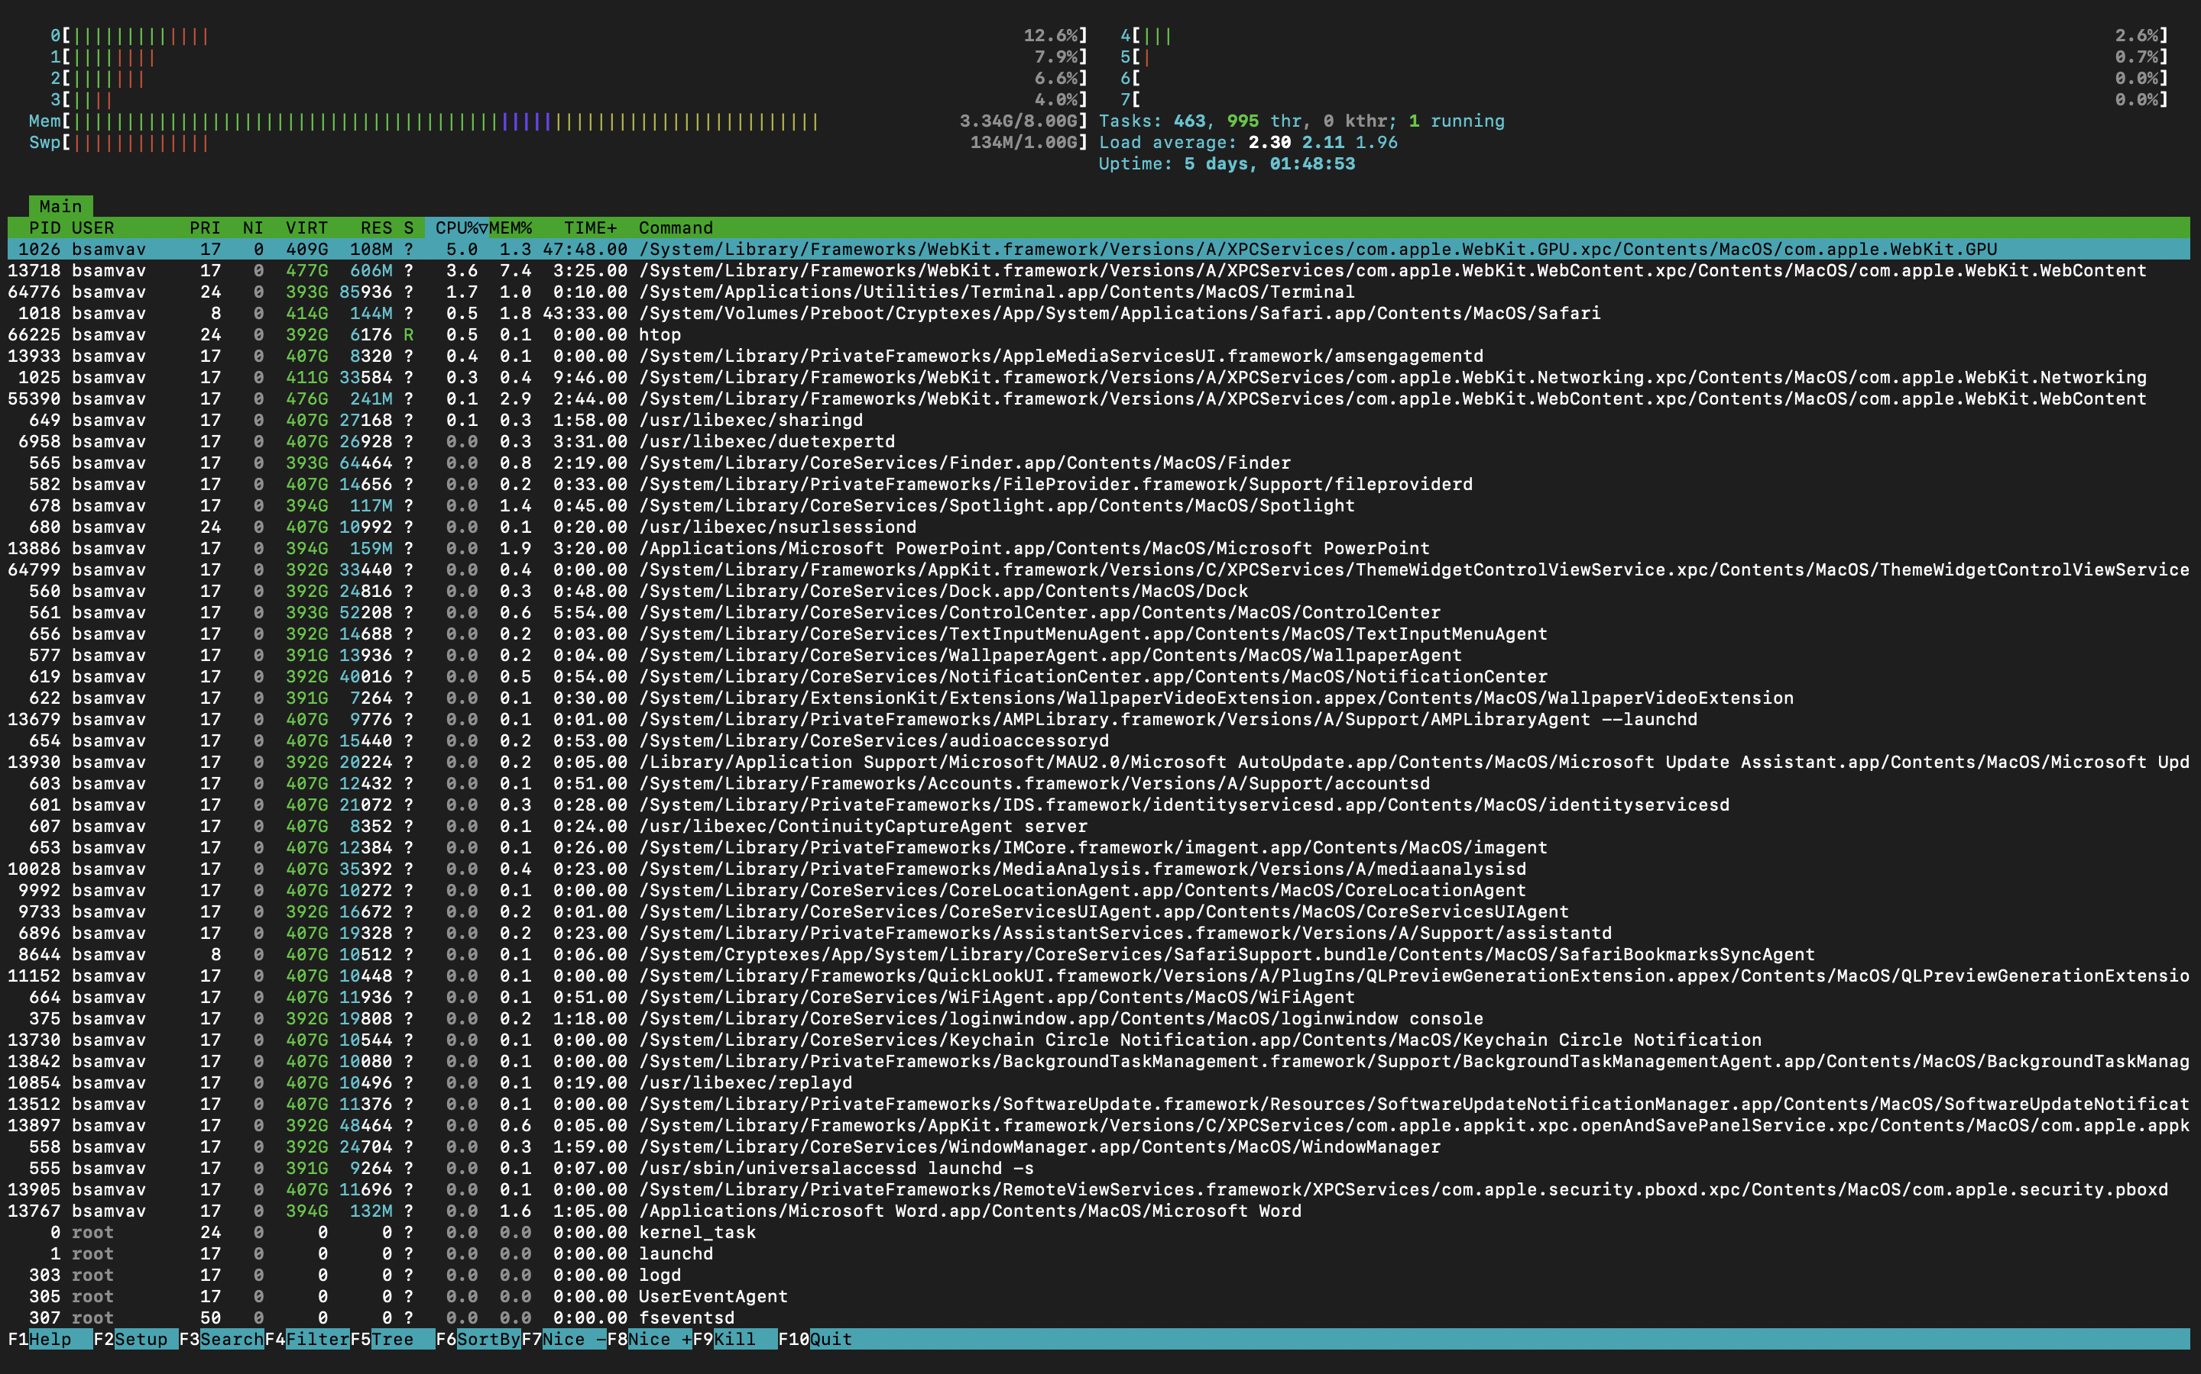
Sample Command and Output: Htop

Slide 6
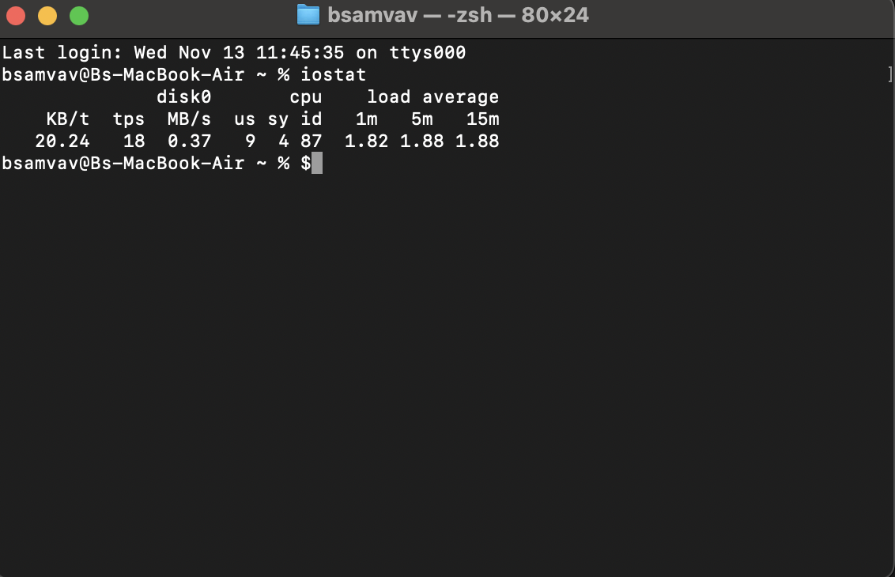
Sample Command and Output: IOSTAT

Slide 7
Memory Usage
Overview: Monitoring memory usage is crucial for identifying processes that are using large amounts of RAM, which could lead to system slowdowns or crashes.
Commands:
memory_pressure: Gives an overview of memory pressure, which reflects how well the system is handling memory demands.
vm_stat : Provides memory usage in terms of pages, which you can convert to bytes (each page is typically 4096 bytes).

Slide 8
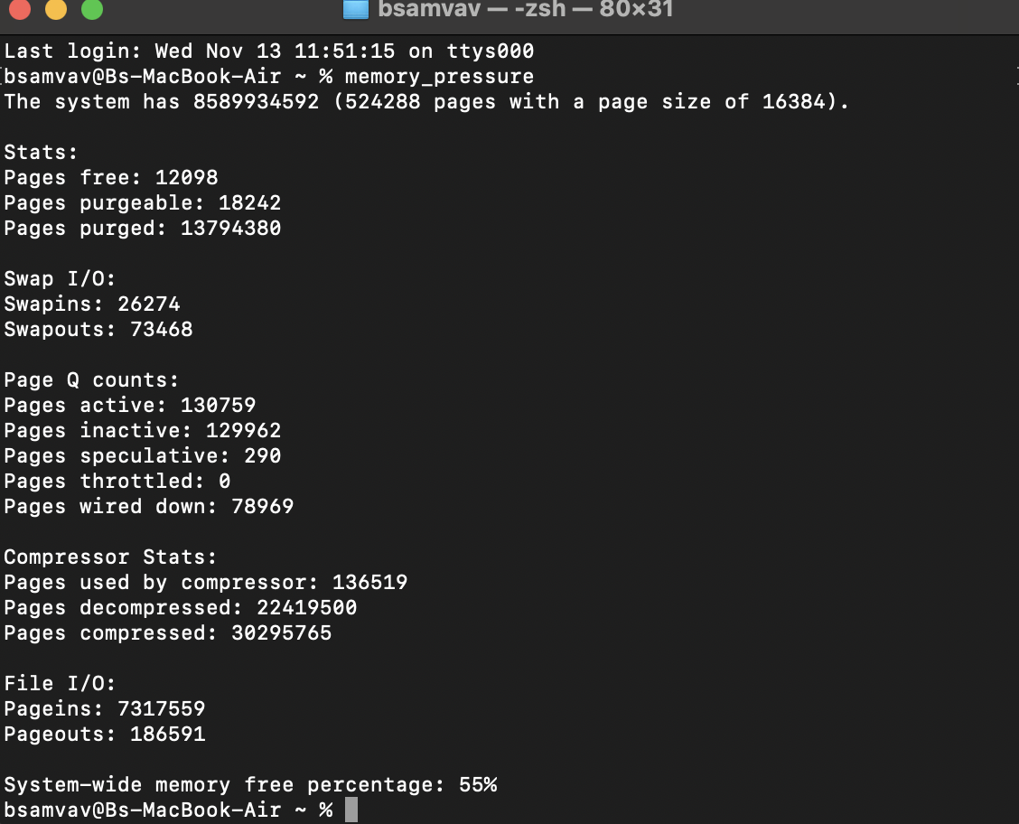
Sample Command and Output: MEMORY_PRESSURE

Slide 9
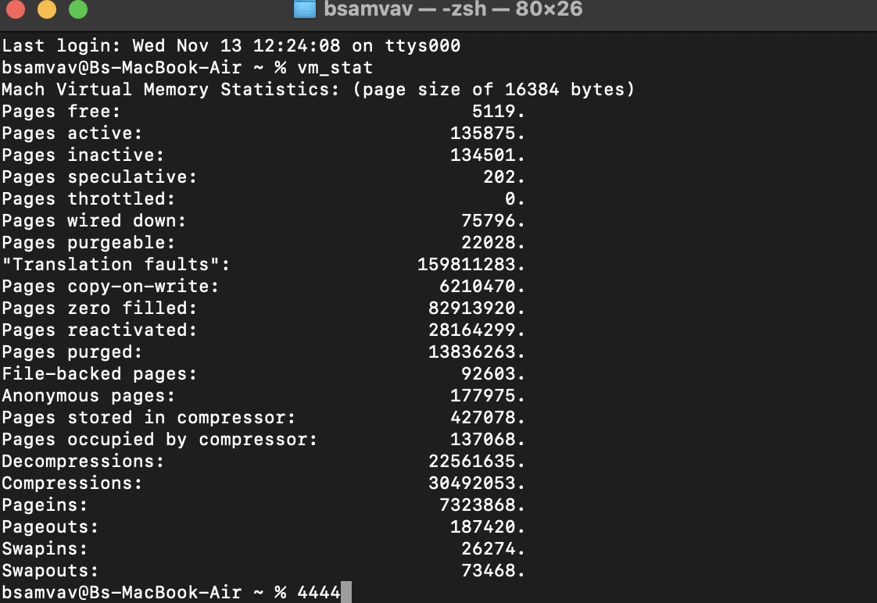
Sample Command and Output: VM_STAT

Slide 10
Disk Usage
Overview: Keeping track of disk usage helps prevent storage from becoming full, which could negatively impact system performance.
Commands:
df -h : Shows disk usage for all mounted filesystems in a human-readable format.
du -h [directory] : Displays disk usage by specific directories and files in a readable format.

Slide 11
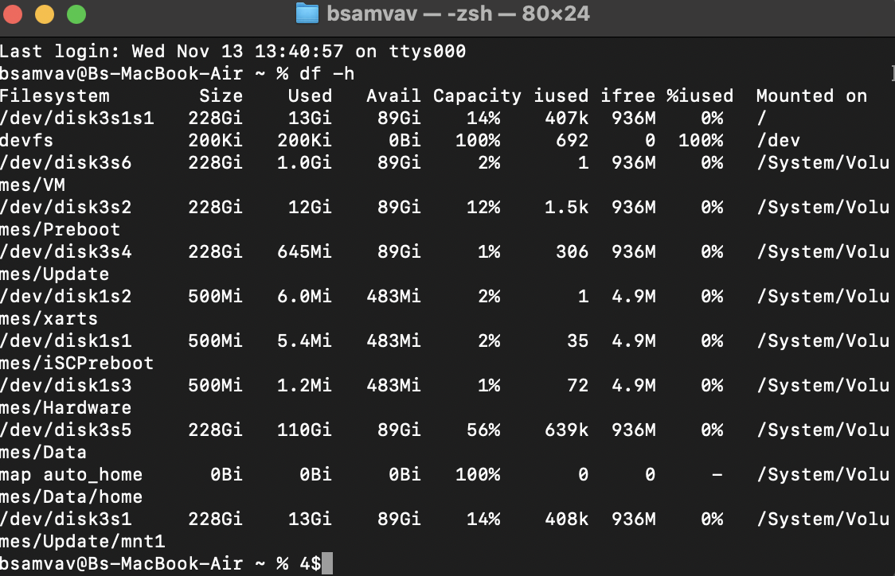
Sample Command and Output: df -h

Slide 12
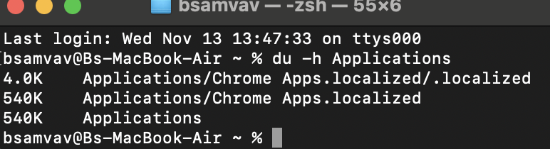
Sample Command and Output: du -h [directory]

Slide 13
Log Files
Overview: Log files offer valuable information on system events, errors, and user activity, which are essential for troubleshooting and security monitoring.
Common Log Locations:
/var/log/system.log : Contains general system messages.
/var/log/install.log : Logs related to software installations and updates.
dmesg : This command shows recent system events stored in the kernel’s memory buffer

Slide 14
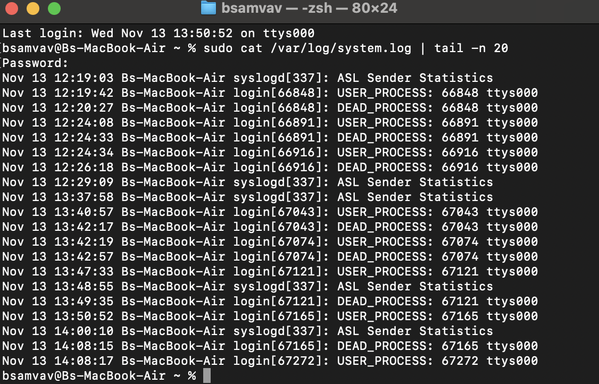
Sample Command and Output: du -h [directory]

Slide 15
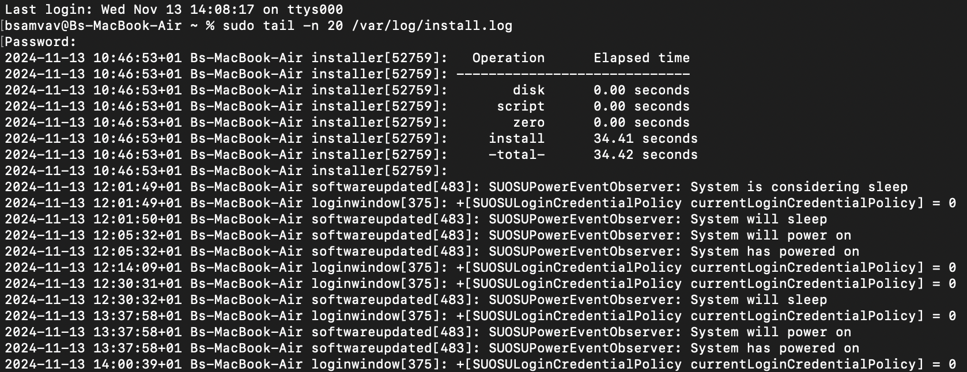
Sample Command and Output: /var/log/install.log

Slide 16
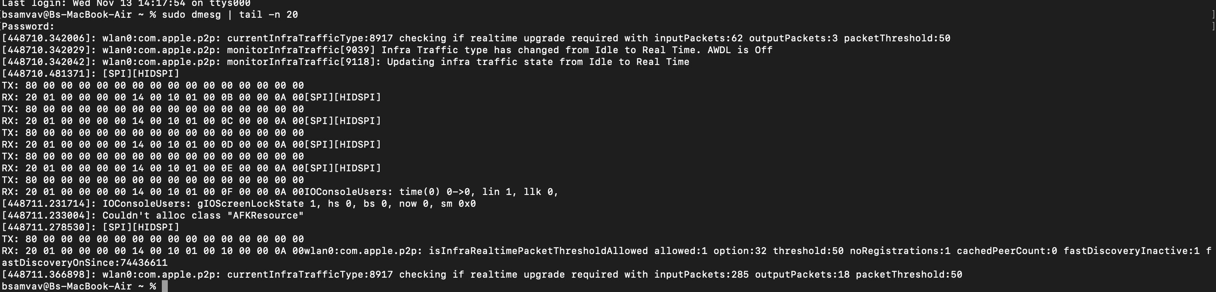
Sample Command and Output: dmesg

Slide 17
User Activity Monitoring
Overview: Tracking user activity helps maintain system security by recording user logins and actions.
Commands:
last : Displays a list of recent user logins.
who : Displays current users and their activities.

Slide 18
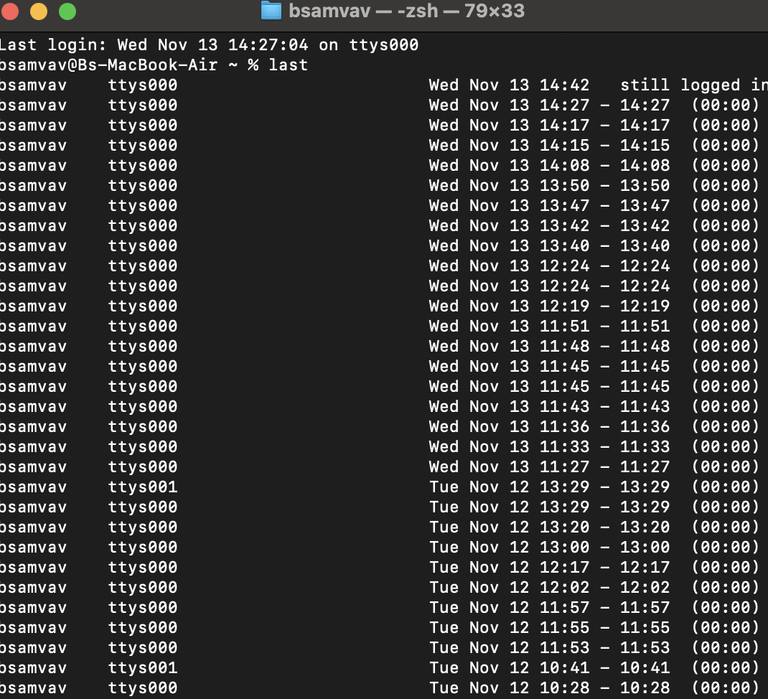
Sample Command and Output: LAST

Slide 19
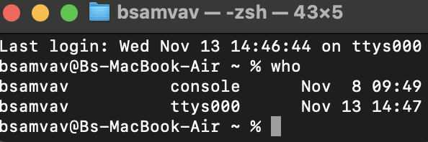
Sample Command and Output: WHO

Slide 20
System Uptime and Load Statistics
Overview: Monitoring uptime and load averages provides insight into system stability and the overall workload.
Commands:
uptime - Displays system uptime along with the load averages.
sysctl vm.loadavg - Directly shows load averages from the system.

Slide 21
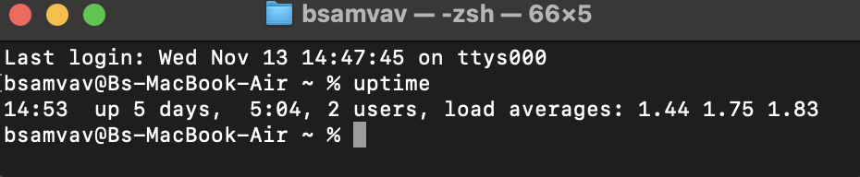
Sample Command and Output: UPTIME

Slide 22
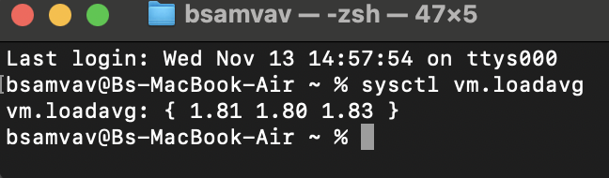
Sample Command and Output: sysctl vm.loadavg

Slide 23
Network Usage Monitoring
Overview: Observing network traffic helps identify abnormal bandwidth consumption, which could point to potential issues or heavy traffic.
Commands:
netstat - Shows network connections, routing tables, and interface statistics
iftop - A real-time tool to monitor network bandwidth usage.

Slide 24
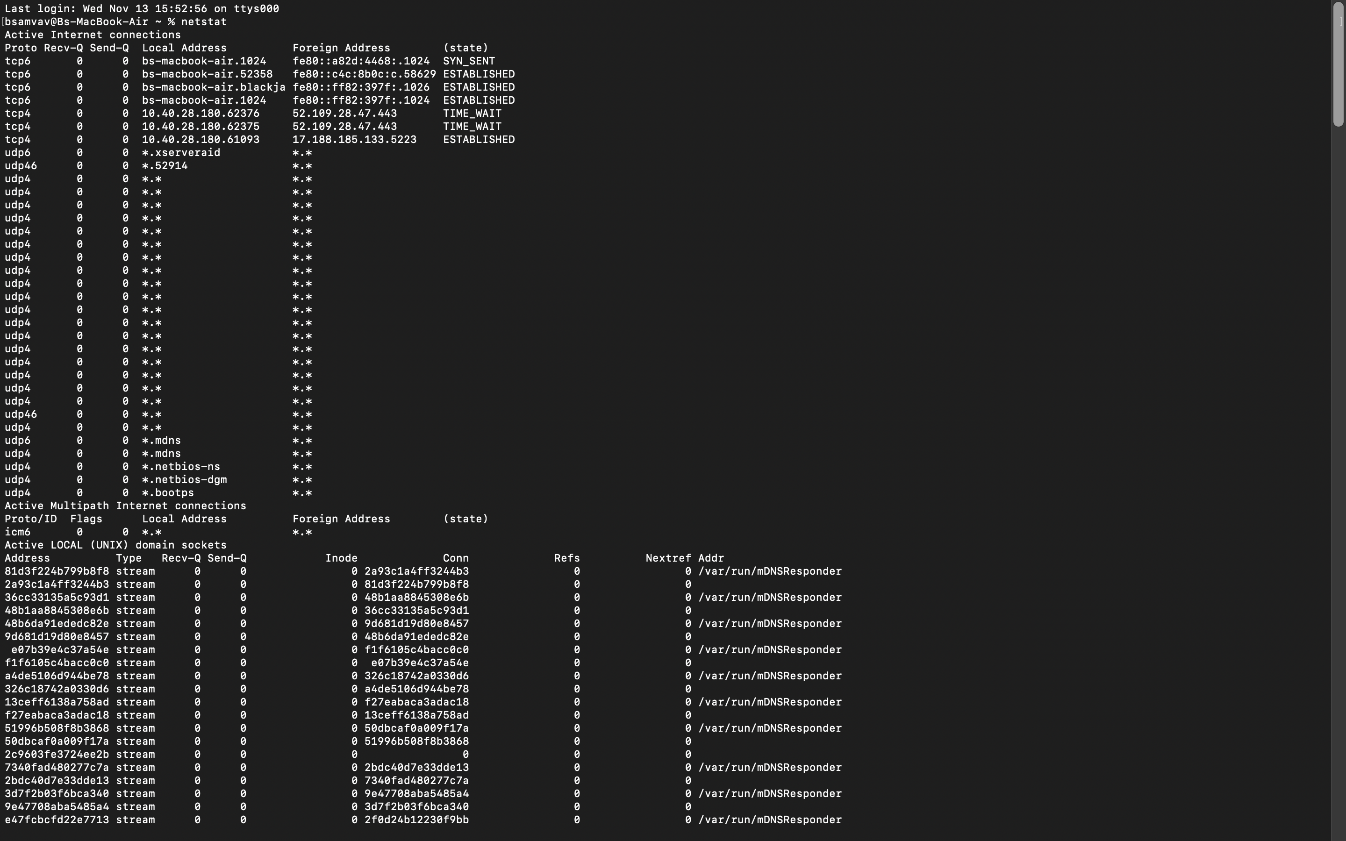
Sample Command and Output: netstat

Slide 25
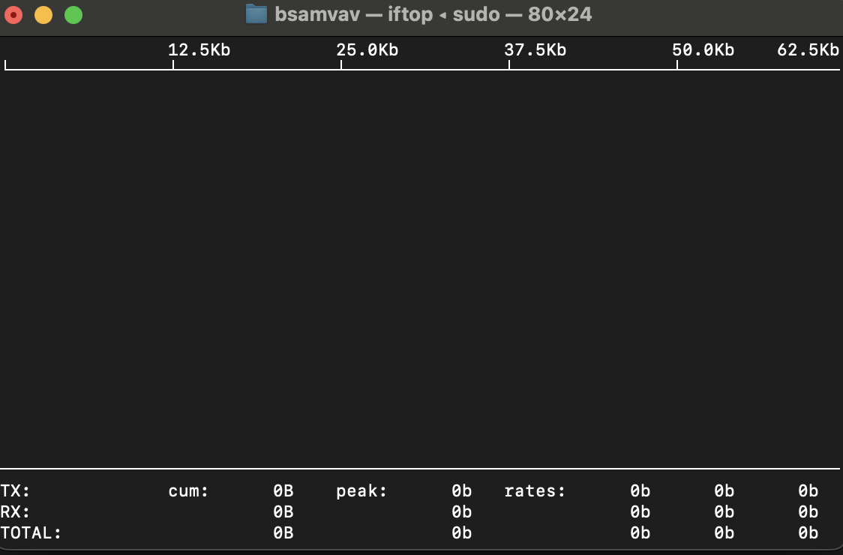
Sample Command and Output: iftop

Slide 26
Conclusion
Regular monitoring of a Unix-based system is essential for maintaining its health and security. By reviewing CPU, memory, disk usage, and network traffic can prevent performance issues and security vulnerabilities. Tracking user activity and system logs is also crucial for troubleshooting. Proactive checks and maintenance are key to ensuring optimal system performance.

